Slide 1


Karol Kosyra
15 January 2023

Slide 2

Outline
Executive Summary
Introduction
Methodology
Results
Conclusion
Appendix

Slide 3
Executive Summary
Summary of methodologies
Data collection
Data wrangling
Exploratory Data Analysis with Data Visualization and SQL
Interactive Visual Analysis with Folium and Plotly Dash
Predictive analysis using Classification Models
Summary of all results
Exploratory Data Analysis results
Interactive analytics demo in screenshots
Predictive analysis results

Slide 4
Introduction
Project background and context
SpaceX advertises Falcon 9 rocket launches on its website with a cost of 62 million dollars; other providers cost upward of 165 million dollars each, much of the savings is because SpaceX can reuse the first stage. Therefore if we can determine if the first stage will land, we can determine the cost of a launch. This information can be used if an alternate company wants to bid against SpaceX for a rocket launch
Problems you want to find answers
What affects the success of landing
Predict if the Falcon 9 first stage will land successfully

Slide 5

Section 1

Slide 6
Methodology
Executive Summary
Data collection methodology:
SpaceX API and WebScrapping from Wikipedia
Perform data wrangling
Dealing with Missing Values
Creating a landing outcome label
Applying OneHotEncoding and StandardScaler
Perform exploratory data analysis (EDA) using visualization and SQL
Perform interactive visual analytics using Folium and Plotly Dash
Perform predictive analysis using classification models
Splitting data to train and test datasets
Evaluating accuracy by finding best parameters using Grid Search and Cross Validation

Slide 7
Data Collection
Data was collected from two sources:
SpaceX API using GET request
Rocket launches from: https://api.spacexdata.com/v4/launches/past
Booster names from: https://api.spacexdata.com/v4/rockets
Launch Site name and coordinates from: https://api.spacexdata.com/v4/launchpads
Payload mass and Orbit destination from: https://api.spacexdata.com/v4/payloads
Details about core and flights from: https://api.spacexdata.com/v4/cores
Wikipedia page using WebScrapping with BeautifulSoup library
Web page: https://en.wikipedia.org/w/index.php?title=List_of_Falcon_9_and_Falcon_Heavy_launches&oldid=1027686922
This web page contains data valid for date 9 June 2021

Slide 8
Data Collection – SpaceX API
Rocket Launches:
Using GET request to /launches/past receive information about SpeceX launches
Decode response using json and json_normalize to transform data to Pandas DataFrame
Booster names:
For each `rocket` in Launches dataset GET request to /rockets/{rocket}
Transform response to json then extract booster name and store it in list variable
Final DataFrame:
Gather all lists received from API to one dictionary
Create Pandas DataFrame from prepared dictonary
Filter data to `Falcon 9` only
Launch Site name and coordination:
For each `launchpad` in Launches dataset GET request to /launchpads/{launchpad}
Transform response to json then extract Launch details and store it in list variable
Payload mass and Orbit destination:
For each `payloads` in Launches dataset GET request to /payloads/{payloads}
Transform response to json then extract payload mass and orbit and store it in list variable
Core details:
For each `core` in Launches dataset GET request to /cores/{core}
Transform response to json then extract core details and store it in list variable
Link to notebook on GitHub: https://github.com/Karlos754/IBM-Data-Science/blob/master/jupyter-labs-spacex-data-collection-api.ipynb

Slide 9
Data Collection - Scraping
GET request to Wikipedia page with Falcon 9 Launches
Create BeautifulSoup object from response
Extract all `table` elements from page using `find_all` function
Iterate through <th> elements to extract column names
Extract data for each column and store it in dictionary
Create Pandas DataFrame from prepared dictionary
Link to notebook on GitHub: https://github.com/Karlos754/IBM-Data-Science/blob/master/jupyter-labs-webscraping.ipynb

Slide 10
Data Wrangling
Identify missing values in key variables
Replace missing values in PayloadMass with mean of all Launches
Check data types of variables
Determine the number of launches on each Launch Site using value_counts()
Determine the number of occurrence of each orbit
Calculate the number and occurence of mission outcome per orbit type
Create a Class variable with landing outcome lable from Outcome variable
Check average success rate for all launches
Link to notebook on GitHub: https://github.com/Karlos754/IBM-Data-Science/blob/master/jupyter-labs-webscraping.ipynb

Slide 11
EDA with Data Visualization
Scatter point charts using seaborn to see:
How Flight Number and Payload mass affect launch outcome
What is the distribution of Launch Site over Flight Number and with what outcome
If there is any relationship between Payload Mass and Launch Site
What is the distribution of Orbit type over Flight Number
Relationship between payload and orbit type
Bar chart to visualize success rate of each orbit type
Line chart to show success yearly trend
Link to notebook on GitHub: https://github.com/Karlos754/IBM-Data-Science/blob/master/jupyter-labs-eda-dataviz.ipynb

Slide 12
EDA with SQL
SELECT:
unique launch sites in the space mission
5 records where launch sites begin with the string 'CCA’
total payload mass carried by boosters launched by NASA (CRS)
average payload mass carried by booster version F9 v1.1
date when the first successful landing outcome in ground pad was achieved
names of the boosters which have success in drone ship and have payload mass greater than 4000 but less than 6000
total number of successful and failure mission outcomes
names of the booster versions which have carried the maximum payload mass
failed landing outcomes in drone ship, their booster versions, and launch site names for in year 2015
Rank the count of landing outcomes (such as Failure (drone ship) or Success (ground pad)) between the date 2010-06-04 and 2017-03-20, in descending order
Link to notebook on GitHub: https://github.com/Karlos754/IBM-Data-Science/blob/master/jupyter-labs-eda-sql-coursera.ipynb

Slide 13
Build an Interactive Map with Folium
Marker and Circle objects added to mark and highlight area of:
all launch site on the map
success and failed launches for each site on the map
Line objects to estimate distance from closest:
Coastline
City
Railway
Highway
Link to notebook on GitHub: https://github.com/Karlos754/IBM-Data-Science/blob/master/lab_jupyter_launch_site_location.ipynb

Slide 14
Build a Dashboard with Plotly Dash
Dashboard created with Plotly Dash contains:
Pie chart with dropdown menu to select Launch site. If specific Launch Site is not selected then % of Total launches per site is showed. When Launch Site is selected then Successful launch rate is showed on graph.
Scatter point chart with Range Slider to filter Payload Mass. Graph shows relationship between Payload Mass and Launch success rate.
Link to notebook on GitHub: https://github.com/Karlos754/IBM-Data-Science/blob/master/spacex_dash_app.py

Slide 15
Predictive Analysis (Classification)
5 classification algorithms were used to predict landing result of Falcon 9:
Logistic Regression, Supported Vector Machine, Decision Tree, K-Nearest Neighbors.
Accuracy has been chosen as evaluation metric.
Following steps was applied to prepare classification model:
Futures Engineering: Apply OneHotEncoder to categorical columns
Cast all numeric columns to float64
Assign target column to separate numpy variable (to keep original values)
Standarize data using StandardScaler
Split data into training and testing data using function train_test_split
Find best hyperparameters using Grid Search and Cross Validation on training data
Calculate accuracy on test data
Choose best model and parameters
Link to notebook on GitHub: https://github.com/Karlos754/.../SpaceX_Machine%20Learning%20Prediction_Part_5.ipynb

Slide 16
Results
Exploratory data analysis results
Interactive analytics demo in screenshots
Predictive analysis results

Slide 17

Section 2

Slide 18
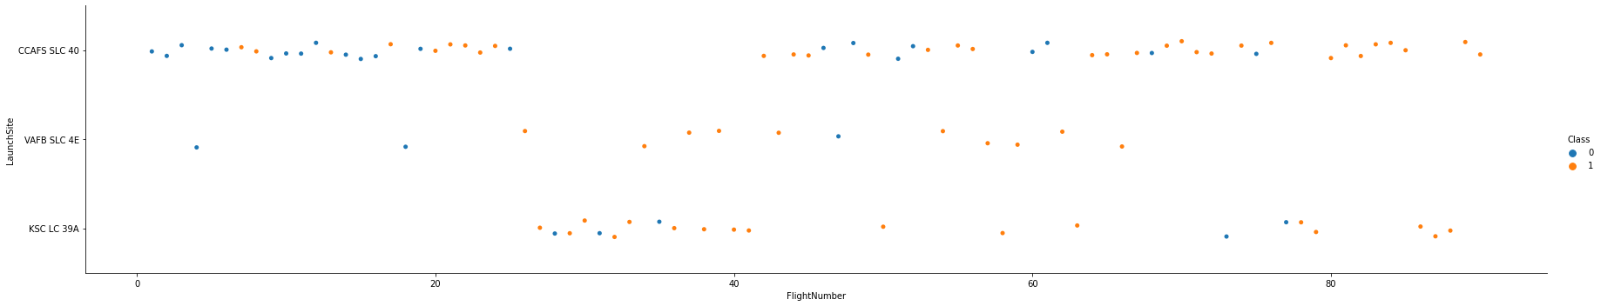
Flight Number vs. Launch Site
CCAFS SLC-40 is most likely Launch Site to use. However after about 23 flights they change it mainly to KSC LC-39A for like 20 flights and then they resume flights from CCAFS SLC-40 with higher landing success rate

Slide 19
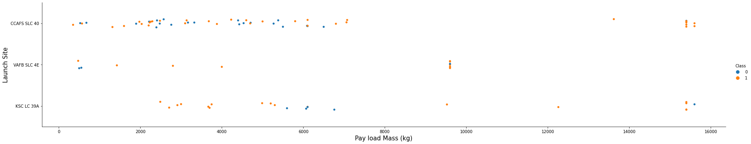
Payload vs. Launch Site
CCAFS SLC-40 Launch Site is very successful for heavy payload mass (> 13k kg)
VAFB SLC-4E has no launches for heavy payloads
KSC LC-39A is successful for light payloads (< 5 800 kg)

Slide 20
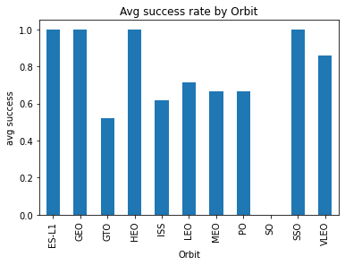
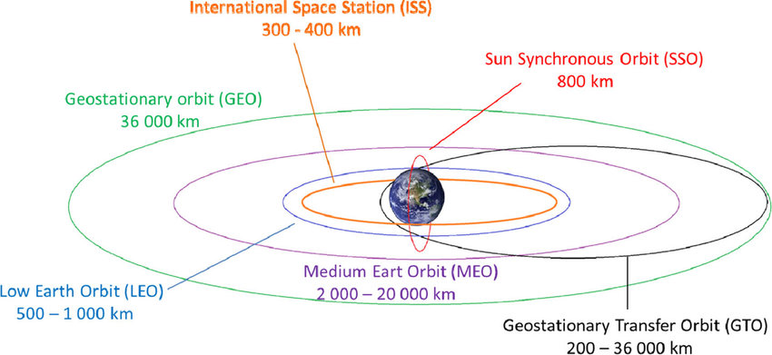
Success Rate vs. Orbit Type
Launches success rate for GTO and ISS orbits is below average however this destination was mostly used.
Some Orbits have high success rate but there was just a few launches on this orbits.

Slide 21
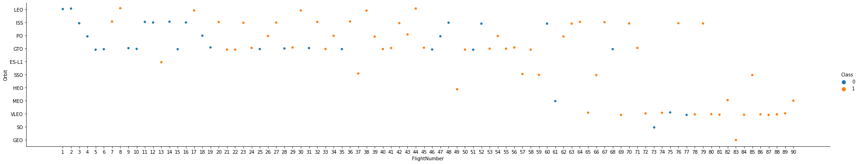
Flight Number vs. Orbit Type
LEO Orbit has successful flights just after 3 launches on this Orbit
VLEO Orbit is mostly chosen after 70th flight

Slide 22
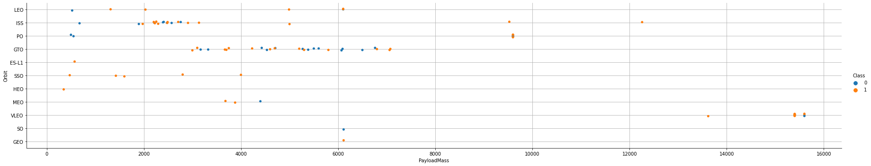
Payload vs. Orbit Type
With heavy payloads the successful landing or positive landing rate are more for Polar,LEO and ISS.
However for GTO we cannot distinguish this well as both positive landing rate and negative landing(unsuccessful mission) are both there here.

Slide 23
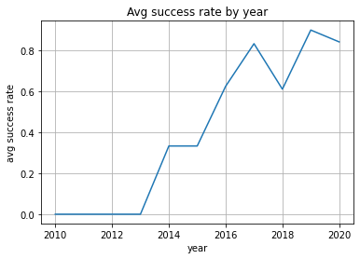
Launch Success Yearly Trend
Successful flights started in 2013
Between 2015 and 2017 was significant increase of successful flights
Little decrease was in 2018 but since then its increasing again

Slide 24
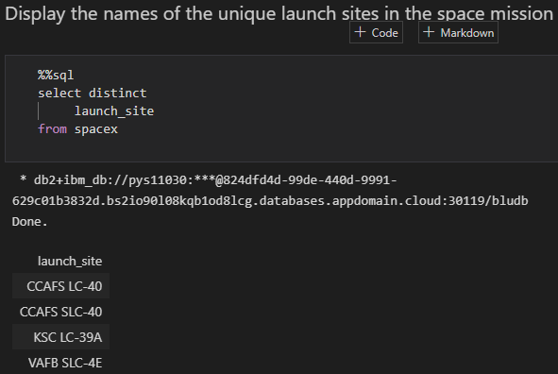
All Launch Site Names
`distinct` statement was used to select unique launch_site names

Slide 25
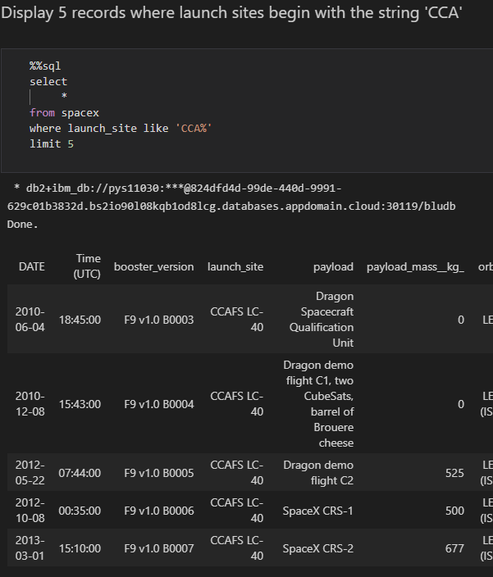
Launch Site Names Begin with 'CCA'
To select records `where` clause was used with `like` statement to select only this records where launch_site name begins with CCA. `%` in like statement string is a wildcard and it means that there can be some text after this phrase.
`limit 5` statement was used to select only 5 records

Slide 26
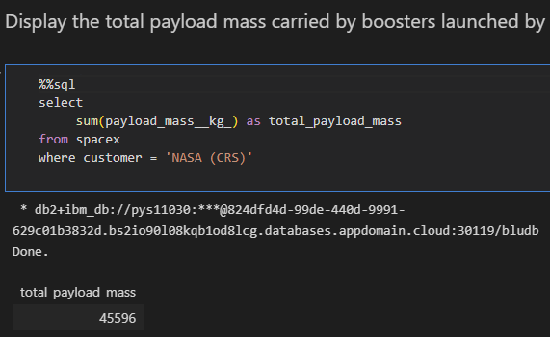
Total Payload Mass
To display total payload mass for ‘NASA (CRS)’ customer can use sum() function and where clause

Slide 27
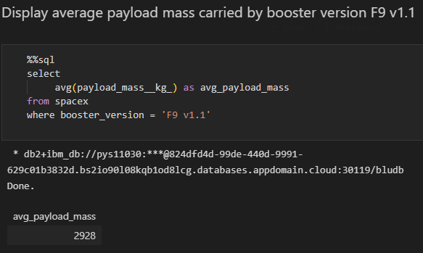
Average Payload Mass by F9 v1.1
To select average payload mass we can use avg function with `where` clause to filter only ‘F9 v1.1’ booster

Slide 28
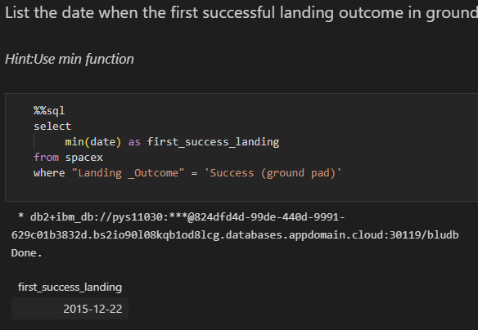
First Successful Ground Landing Date
To display first date for successful ground pad landing we can use min() function and `where` clause to filter data

Slide 29
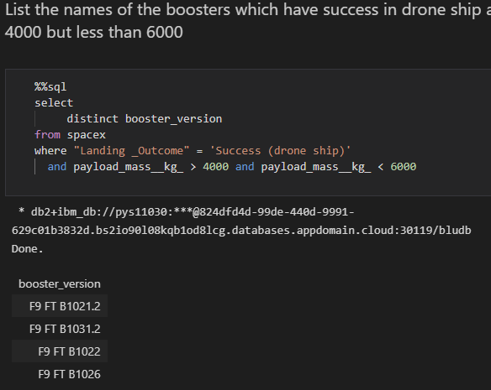
Successful Drone Ship Landing with Payload between 4000 and 6000
There are 4 boosters which successfully landed on drone ship with payload mass between 4000 and 6000 kg

Slide 30
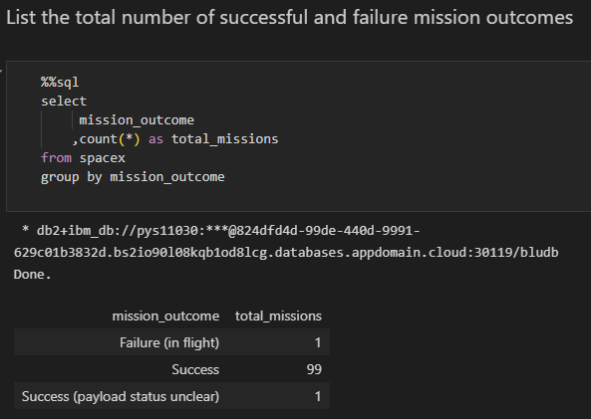
Total Number of Successful and Failure Mission Outcomes
To calculate total number of mission_outcome we can use count() function with `group by` clause to indicate for which column we want to count records

Slide 31
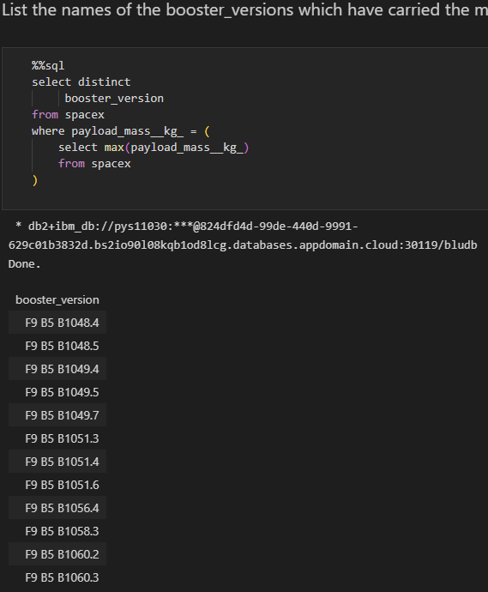
Boosters Carried Maximum Payload
To select unique booster_versions which have carried max payload mass we can use `distinct` statement to remove duplicated names in output and subquery in `where` clause to filter only this records with highest payload mass using max function in subquery.

Slide 32
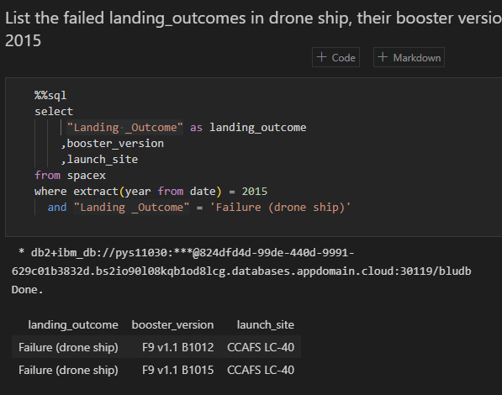
2015 Launch Records
To select records only for missions in 2015 we can use extract() function in `where` clasue

Slide 33
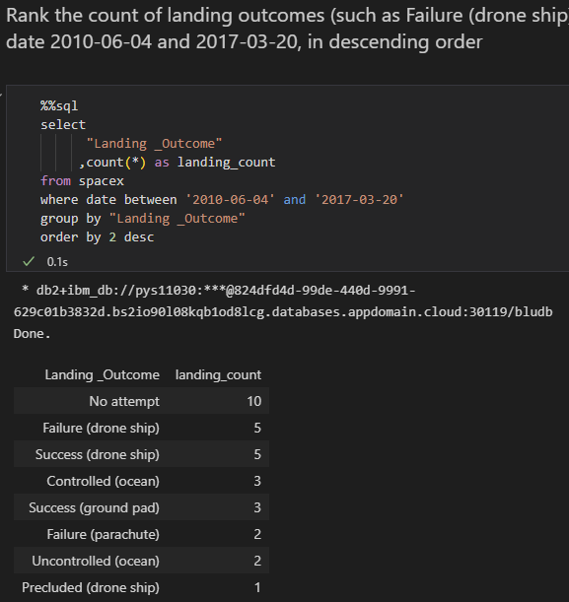
Rank Landing Outcomes Between 2010-06-04 and 2017-03-20
To rank the count of landing outcomes we have to `group by` result by landing_outcome, use count() function and sort output using `order by` clause (by 2nd output column – landing_count) descending (from highest to smallest)

Slide 34

Section 3

Slide 35
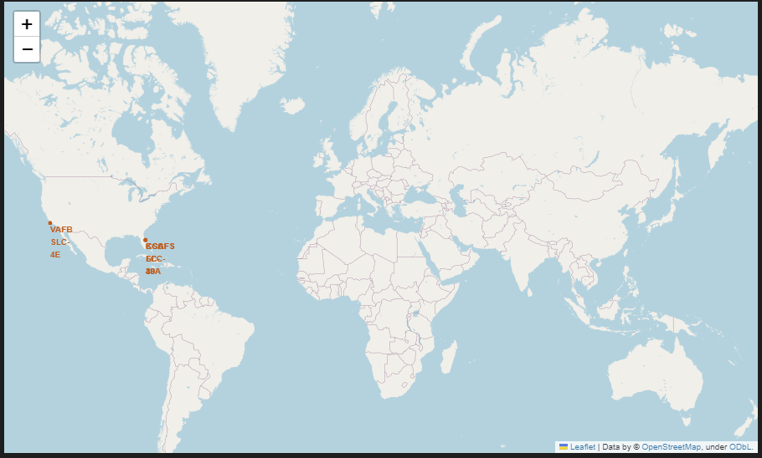
Launch Sites locations
Launch Sites are located in USA (California and Florida)

Slide 36
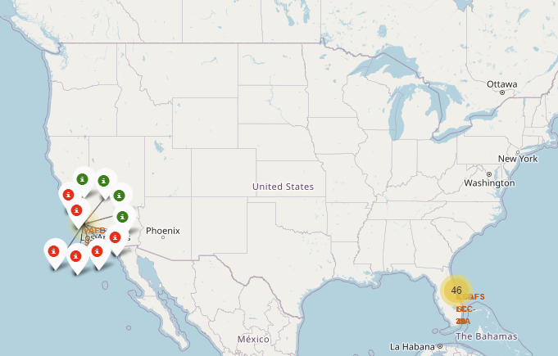
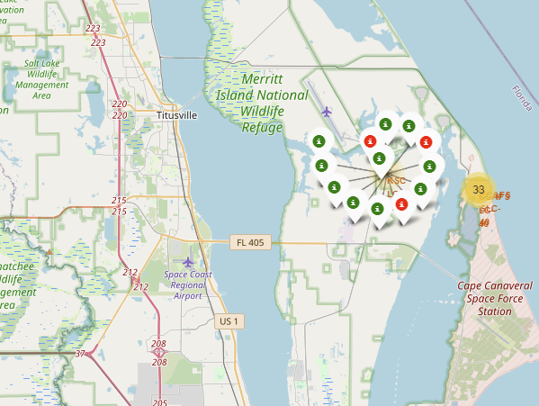
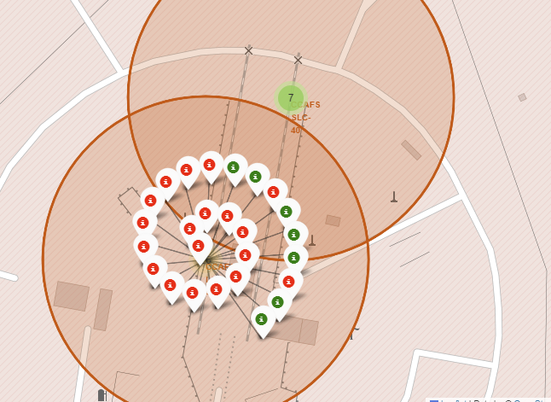
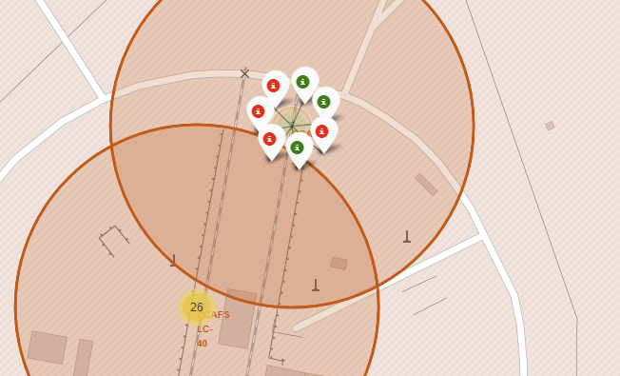
Success and failed launches
Green markers represent successful launches
Red markers represent failed launches

Slide 37
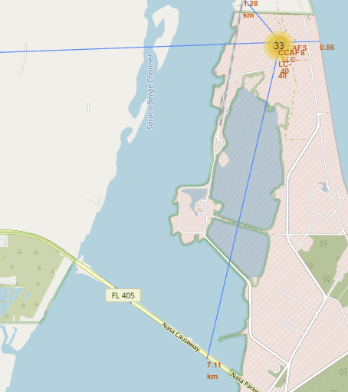
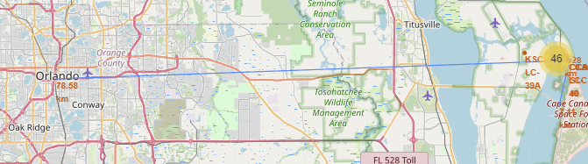
Launch Site distance to some landmarks
Launch Site in Florida are located near coastline (~0.86km) and railway (~1.28km) but far from city (nearest Orland is ~78km away)

Slide 38

Section 4

Slide 39
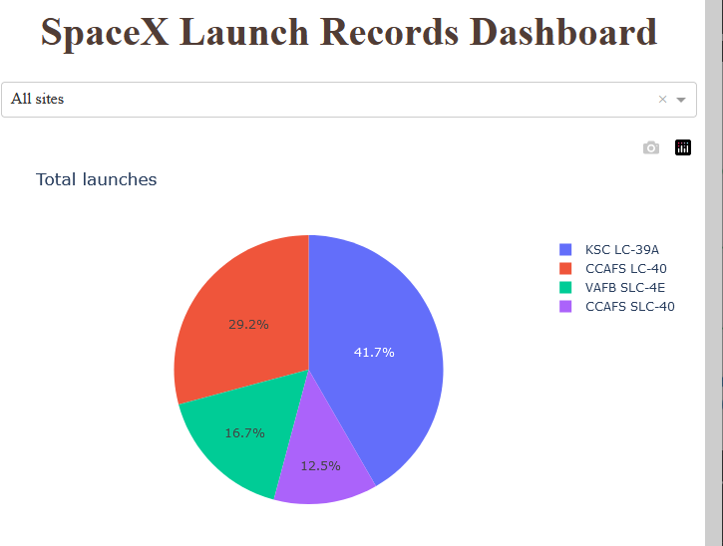
Success launch rate for all Sites
KSC LC-39A is Site with most total launches (41.7%)
CCAFS SLC-40 has the least launches of all Sites (12.5% of total)

Slide 40
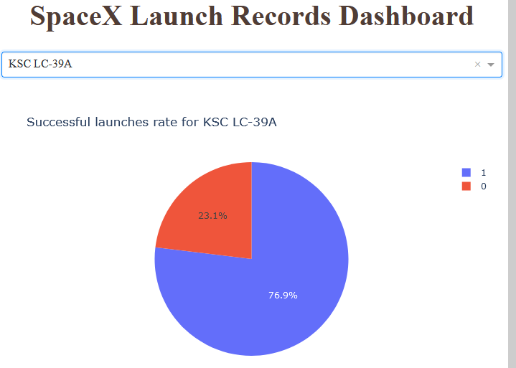
<Dashboard Screenshot 2>
KSC LC-39A as most used Launch Site has high success rate – 76.9%

Slide 41
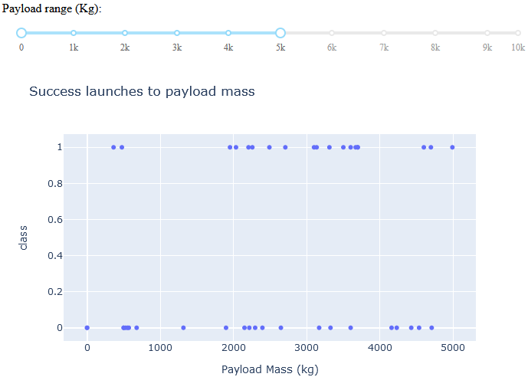
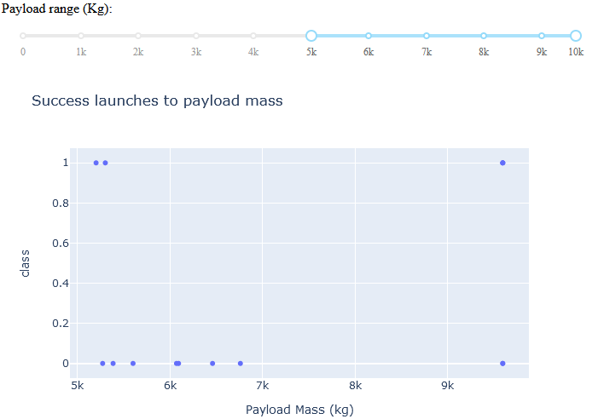
Influence of Payload mass to launch outcome
There is much more launches with payload mass < 5 000 kg
Launch success rate is much more higher for payload mass < 5 000kg

Slide 42

Section 5

Slide 43
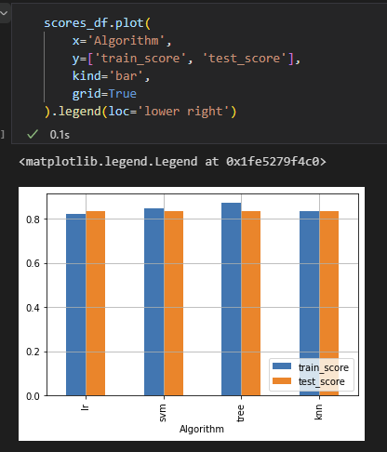
Classification Accuracy
All 4 models have the same accuracy on test data (83%) however Decision Tree has better result on train data (87%).

Slide 44
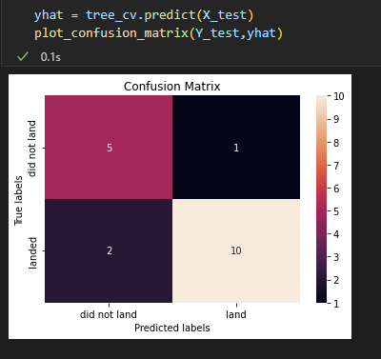
Confusion Matrix
Decision Tree model correctly predicted 5 failed landings (True Negative) and 10 success landings (True Positive).
It incorrectly predicted success landing when it was failure in 2 records (False Positive) and one failure when it was success (False Negative)

Slide 45
Conclusions
SpaceX landing success rate increasing every year
Heavy payload mass used in late flights (above 70th) have high success landing rate
For this small dataset to predict landing succession all 4 models have similar accuracy
Taking into account accuracy on training and testing dataset we can indicate Decision Tree as model to use.

Slide 46
Appendix
None

Slide 47


